Slide 1
JIRA PoC IT Steering Committee Backup Materials

Slide 2
Agenda
Enterprise Software Development Tools Alignment
JIRA Overview
JIRA Implementation Vendor Selection
JIRA PoC Deliverables from Vendor
JIRA PoC Proposed Costs and Schedule
Backup : JIRA PoC Usability Requirements; JIRA MSRP

Slide 3
Software Development Tools Alignment Goals
Provide Enterprise Grade Common tools across HGST
Software teams from HDD, S3 (sTec, Virident, Velobit) want alignment to common tools to improve our workflow for efficiency, quality and improve collaboration capabilities across teams
Software teams prefer common tools delivered, maintained and supported by IS&T
IS&T leading effort with stakeholders from main teams
Aligned with Innovation and Software PLC Leadership as well
Will use ISnT PMO process for governance and project management
Working to address following common tools in next 6-8 months
Defect Tracking
Software Repository/Build/Code Review (a tightly integrated workflow)
Software Code Compliance
This project is a Proof of Concept (PoC) to build and test a common Defect Tracking solution

Slide 4
“Light Weight” Software Tools and Processes Survey
 | Development Process | SCM | Build | Defect Tracking | Test Tracking | Instant Messaging | Code Reviews
Foundation Pak | Hybrid | Mercurial | Homegrown scripts (automated builds, email notifications) | Bugzilla | TestLink Google Docs | SameTime Skype | Peer+ Review Board
FMC | Agile + Rally | SVN | Homegrown Utilities + Jenkins | Bugzilla 4.2.2 | TestLink Google Docs | Skype | Review Board
Virident Driver | Waterfall | SVN | Homegrown Utilities | Bugzilla 4.2.2 – want JIRA | TestLink | Skype | Review Board
HGST Driver & FW |  | Git (in plan) | Jenkins (in plan) | FogBugz – want JIRA |  |  | Gerrit
HGST G-Tech Tem |  |  |  | JIRA
Cold Storage | Agile | Git | Jenkins | JIRA
Multiple Software Development Teams at HGST either already use JIRA in Silos or prefer to align to use JIRA for defect tracking

Slide 5

Atlasian JIRA
JIRA Overview
JIRA is a proprietary issue tracking product, developed by Atlassian. It provides bug tracking, issue tracking, and project management functions.
Why is JIRA so widely used?
JIRA's flexible plugin architecture spawned a large number of integrations developed by the JIRA development community and third parties, including IDEs like Eclipse and IntelliJ IDEA using the Atlassian IDE Connector. The JIRA API^{[27]} allows developers to integrate third-party applications into JIRA.
According to Atlassian, JIRA is used for issue tracking and project management by over 25,000 customers in 122 countries around the globe.
HGST software development teams agreed aligning to an enterprise JIRA deployment supported by ISnT would be beneficial to projects new and old.

Slide 6
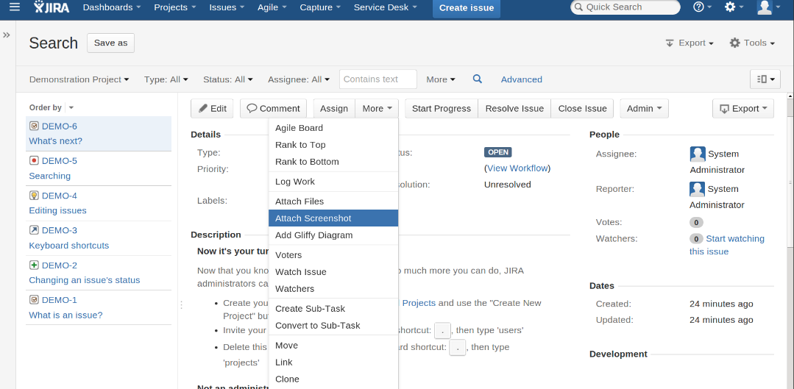
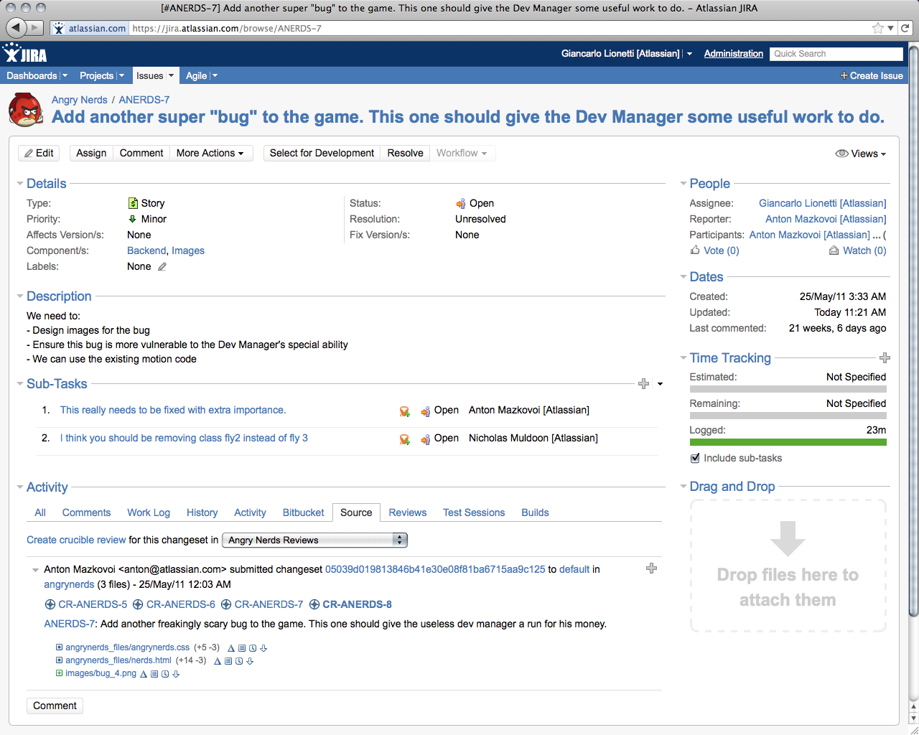
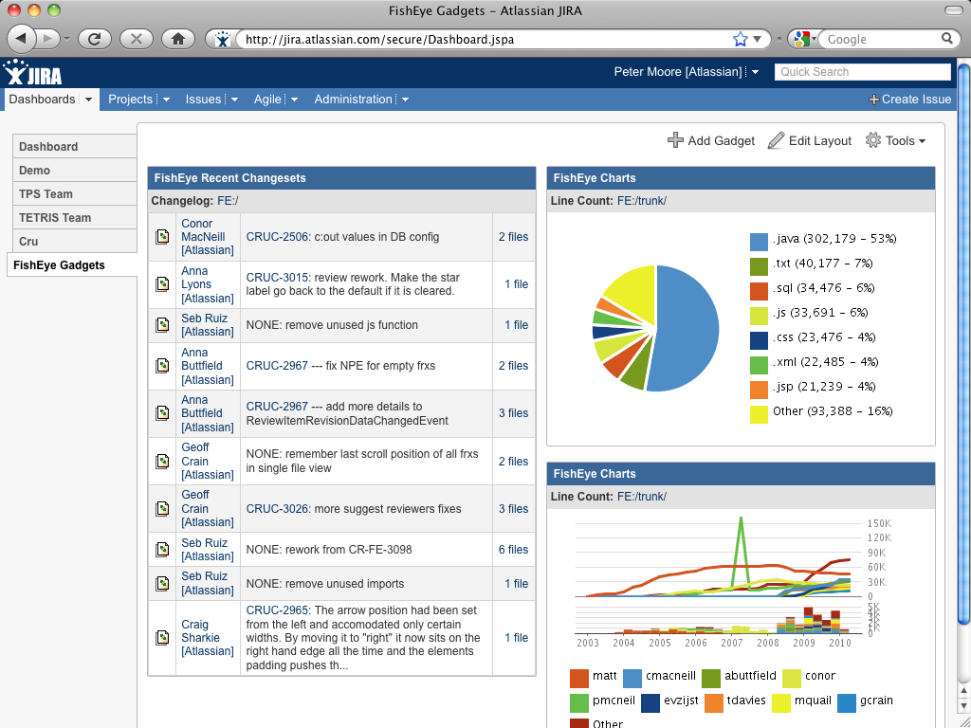
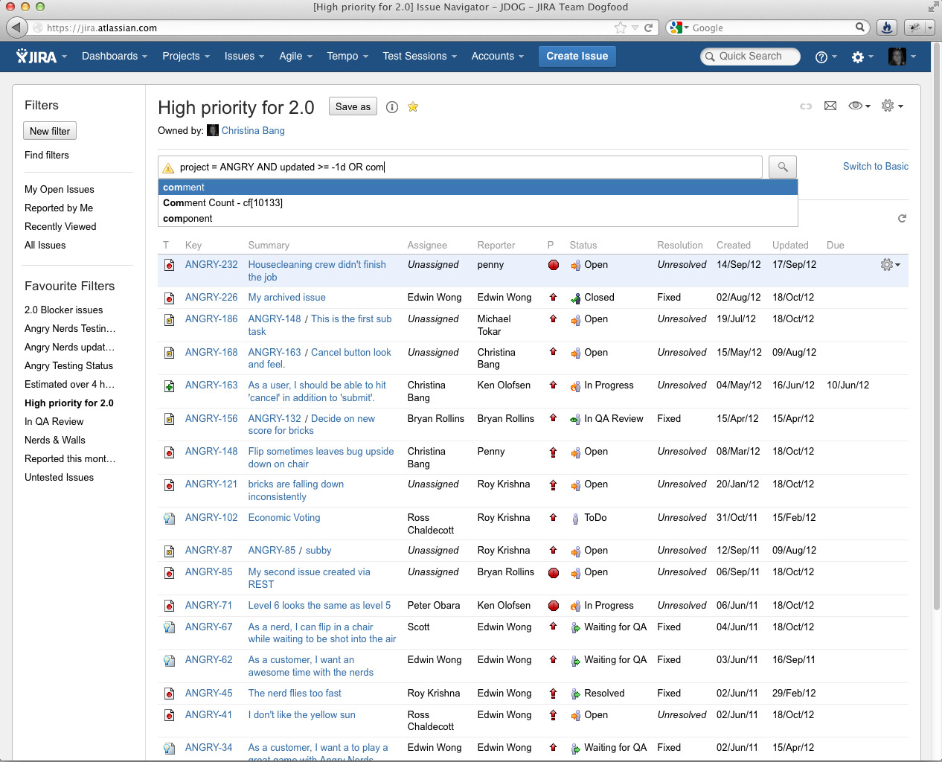
JIRA Screen Shots
A Variety of Views and Details for Filing Bugs / Defects
Very Useful Dashboards and Reporting Capabilities

Slide 7
JIRA: On-Demand vs. Hosted
While many of ISnT’s new products are on-demand (Box, Jive, O365), the current implementation of JIRA On-Demand has many limitations, including
Not all add-ons and connectors to other systems are supported in the On-Demand version
IP Whitelisting (restricting access by source IP range) is currently not possible
Direct access to the database — Not allowed
Port restrictions for external application links — application links to an external application, the external application must use either an HTTP protocol (on port 80) or HTTPS protocol (on port 443)
JIRA On-Demand System Admin privileges are restricted, including
Importing data from non-Atlassian products into On-Demand requires use of a hosted implementation
Configuring LDAP integration
Modifying SysAdmin users & attributes
Deactivating and renaming users
Based Upon HGST Experience, Product Capabilities and Guidance From Atlassian Expert Partners, ISnT Recommending Use of Hosted Version of JIRA

Slide 8
JIRA PoC Third Party Implementer
Atlassian, the JIRA vendor, only provides the software products, basic user and admin training and on-line support through forums
Enterprise grade implementation and professional services are provided by recommended third party partners
Evaluated two third party partners for PoC
Vendors: App Fusion Coyote Creek
Both third party partners highlighted extensive experience with JIRA hosted deployments for large enterprises
Both have teams based in Bay Area
Vendor selection: Coyote Creek
Was more responsive in requests on questions, setting up review meetings, providing needed documentation, .etc.

Slide 9
PoC SoW Deliverables From Coyote Creek To Include
Phase 1 – Build new JIRA environment
Set up desired server or VM and operating system per HGST's standard
Perform basic operating system hardening and put a suitable host-based firewall in place.
Install supported database software.
Configure database software for high performance and high data integrity.
Create database for JIRA per Atlassian’s best practice.
Set up the latest version of Java JDK.
Create user environment for JIRA to run in.
Install the latest version of JIRA and configure it to connect to the database.
Configure Jira to send mail via existing MTA
Set up a default set of screens, schemes, notifications, permissions and workflow to help teams get up to speed quickly on JIRA.

Slide 10
PoC SoW Deliverables From Coyote Creek To Include
Phase 2 – Fogbugz import development
Analyze Fogbugz project and understand the changes that will be needed in Jira to support the import.
Create field mapping table that will be discussed with the project team.
Review Fogbugz workflow and determine what changes will need to be made to operate within Jira's workflow system.
Set up Jira project containing fields, screens and other project components in a similar manner to the Fogbugz project.
Work with the Fogbugz project team to remap any fields and workflow statuses that may be required in order to import the data into Jira
Import Fogbugz project into Jira and correct any issues that come up during the import process.
Once a repeatable process has been identified, perform a final import into Jira and verify that things operate as expected.
Grant permissions to the testing team and release the project to them for evaluation.

Slide 11
JIRA PoC Proposed Costs and Schedule
Proposal from Coyote Creek
$25,900 for T/M of 140 hours @ $185/hour
140 hours ~ 4 weeks of developer time
Total JIRA PoC Forecasted Budget
Will develop detailed 4-6 week PoC schedule with Coyote Creek once JIRA PoC is approved by ITSC
Item | Cost
Coyote Creek Services | $25,900
Atlassian JIRA Eval Licenses | $0.00
VMWare VM Licenses and Serer systems | $0.00
Potential additional expenses | $4,1000
Proposed Total | $30,000
A successful PoC will develop an approved and tested JIRA User environment and framework that is set to scale to production deployment aligned with CobraG development schedule

Slide 12
Backup
JIRA PoC Usability Requirements
JIRA MSRP

Slide 13
JIRA PoC Usability Requirements
Case Entry
1. MUST be able to support multiple and customizable case types (e.g. Bugs, Features, Work Items, etc)
2. MUST be able to support a flexible workflow, meaning we can design our own lifecycle for each case and identify valid states that each case can be in and the available actions (transitions to other states) for each state.
3. MUST be able to support different workflows for different case types (e.g. the workflow for a Bug may be very different than that for a Feature Request)
4. MUST be able to customize the available fields for every case type.
5. MUST be able to support unique sets of fields for each case type (e.g. the available fields in a Bug case may be very different than the fields in a Feature Request case)
6. MUST be able to support attachments (and without a small file size limitation – up to 100 MB)
7. MUST be able to link cases based on parent/child relationships, duplicate, prerequisite dependency, file change dependency, or reference to another case.
8. SHOULD be capable of tracking cases for the current FAR/PMR DB.
9. SHOULD support the ability to require additional info to be entered (e.g. via a pop-up window) during specific state transitions.
10. SHOULD support multiple data types for each field, including single-select pulldown lists, multi-select pulldown lists, radio button selections, and free-form text fields.
11. SHOULD support an enhanced text field for comments which allows formatted texts, pictures and graphics, tables, etc to be inserted into the comments.
12. SHOULD be able to support customizing a subset of mandatory fields that must be set for every new case being opened; other fields may be set to be optionally selected or filled in
13. SHOULD be able to clone a case.
14. SHOULD track all changes in some sort of event log.
15. SHOULD provide a way to record the risk associated with a case.

Slide 14
JIRA PoC Usability Requirements
Integration with other tools
1. MUST support integration with major source control tools (e.g. SVN, GIT)
2. MUST support an open set of APIs whereby other tools and applications can access the case management database directly.
3. MUST contain an integrated peer review tool or be able to link seamlessly to 3rd party peer review tools
4. SHOULD contain web based documentation support (like wiki) or be able to link to 3rd party tool.
5. SHOULD integrate with a discussion forum tool.
Notifications:
1. MUST support configurable email notifications (e.g. State changes, required actions, etc…)
2. MUST support the ability to subscribe to cases.
Reporting / Query / Search Mechanism
1. MUST support a very flexible and easy-to-use means to create customized filters for viewing subsets of cases.
2. MUST be able to save and share custom filters
3. MUST support a rich search function to find pervious occurrences of an issue.
4. MUST be capable of accessing the backend database for advance queries and joins with data not in the case management tool.
5. SHOULD support a rich set of built-in reports and graphs for visualizing case info.
6. SHOULD support the ability to create a user customable Dash Board
7. SHOULD allow organization of Filters.
8. SHOULD be able to export report in a CSV format.

Slide 15
JIRA PoC Usability Requirements
Work / Project Management
1. MUST support an embedded capability to visually view and manage cases, or support a link to external tools to accomplish the same
2. MUST provide a mechanism to size the work for a case or link to external tool that does this.
3. SHOULD support the ability to manage and monitor work estimates (e.g. support the ability to estimate time needed, percent complete, work remaining, tabulate values over specific projects or products, etc)
4. SHOULD support the ability to create project plans (rather than using an external tool like MS Project).
5. SHOULD have a mechanism to prioritize cases for a team.
6. SHOULD have a mechanism to prioritize cases for an entire project.
Code Release Management
1. MUST have the capability to identify the change dependencies (based on file modifications)
2. SHOULD have the capability to manage the case content of a code release.

Slide 16
JIRA PoC Usability Requirements
User Management
1. SHOULD have a way of grouping users by a team (and allow users to be members of more than one team)
2. SHOULD have access control based on a user or team.
3. SHOULD have the ability to link file ownership to a team.
Performance
1. MUST perform at least as well as our current tool.
User Interface
1. MUST provide a web based interface.
2. MUST provide a command line interface on Windows and Linux.
3. SHOULD provide a plugin to standard IDE environments (like Eclipse)
4. SHOULD provide an interface from smart devices

Slide 17
JIRA MSRP Licensing (For Reference Only)
License Pricing (as reference for production deployment)
Number of Users | MSRP Enterprise License Yearly Cost* For JIRA and JIRA Agile
500 | $16,000
2000 | $20,000
10000 | $24,000
*Installation costs and support costs will be extra; will develop detail forecasts of all production costs during PoC

